Slide 1
GEOSOFT TECHNOLOGIES Pvt. Ltd.
GIS/GPS/RS/LBS/CAD/Photogrammetry Services
EXPLORING THE GLOBE THROUGH GEOSPATIAL TECHNOLOGIES…
An ITES Company
Improve your Transportation &Logistics Sectors thru our VTS/GeoILS/GeoMAPS
Scenarios where VTS/GeoILS/GeoMAPS helps alot...

Slide 2
Transportation&Logistics_VTS/GeoILS_Scenarios
Field Service Management: Companies with a field service workforce for services such as repair or maintenance, must be able to plan field workers’ time, schedule subsequent customer visits and be able to operate these departments efficiently. Vehicle tracking allows companies to quickly locate a field engineer and dispatch the closest one to meet a new customer request or provide site arrival information.

Slide 3
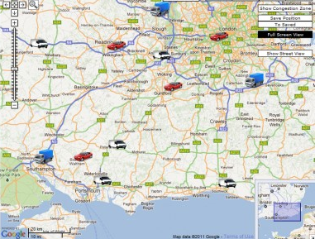
Transportation&Logistics_VTS/GeoILS_Scenarios

Slide 4
Transportation&Logistics_VTS/GeoILS_Scenarios
Field sales: Mobile sales professionals can access real-time locations. For example, in unfamiliar areas, they can locate themselves as well as customers and prospects, get driving directions and add nearby last-minute appointments to itineraries. Benefits include increased productivity, reduced driving time and increased time spent with customers and prospects.

Slide 5
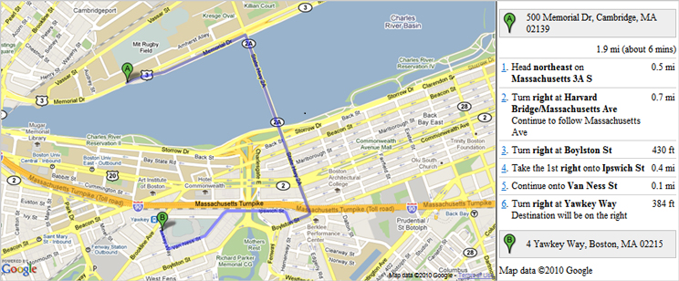
Transportation&Logistics_VTS/GeoILS_Scenarios

Slide 6
Transportation&Logistics_VTS/GeoILS_Scenarios
Stolen Vehicle Recovery: Both consumer and commercial vehicles can be outfitted with RF or GPS units to allow police to do tracking and recovery.

Slide 7
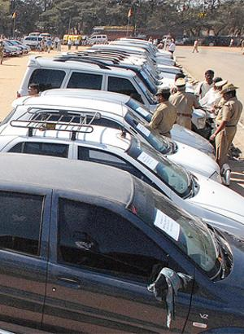
Transportation&Logistics_VTS/GeoILS_
Scenarios

Slide 8
Transportation&Logistics_VTS/GeoILS_Scenarios
Fleet Management: When managing a fleet of vehicles, knowing the real-time location of all drivers allows management to meet customer needs more efficiently.

Slide 9
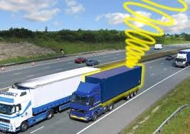
Transportation&Logistics_VTS/GeoILS_Scenarios

Slide 10
Transportation&Logistics_VTS/GeoILS_Scenarios
Trailer tracking: Haulage and Logistics companies often operate Lorries/Trucks with detachable load carrying units. The part of the vehicle that drives the load is known as the cab and the load carrying unit is known as the trailer. There are different types of trailer used for different applications, e.g., flat bed, refrigerated, curtain sider, box container.

Slide 11
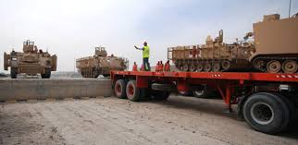
Transportation&Logistics_VTS/GeoILS_Scenarios

Slide 12
Transportation&Logistics_VTS/GeoILS_Scenarios
Surveillance: A tracker may be placed on a vehicle to follow the vehicle's movements.

Slide 13
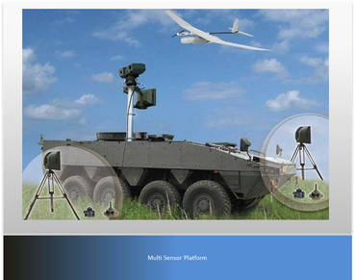
Transportation&Logistics_VTS/GeoILS_Scenarios

Slide 14
Transportation&Logistics_VTS/GeoILS_Scenarios
Transit Tracking: This is the temporary tracking of assets or cargoes from one point to another. Users will ensure that the assets do not stop on route or do a U-Turn in order to ensure the security of the assets.

Slide 15
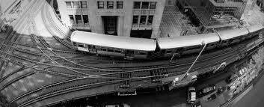
Transportation&Logistics_VTS/GeoILS_Scenarios

Slide 16
Transportation&Logistics_VTS/GeoILS_Scenarios
Fuel Monitoring: This is another important usage of vehicle tracking to monitor the fuel through tracking device.

Slide 17
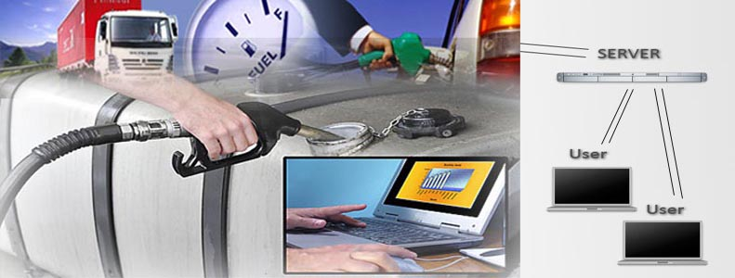
Transportation&Logistics_VTS/GeoILS_Scenarios

Slide 18
Transportation&Logistics_VTS/GeoILS_Scenarios
Distance Calculation: This is an important usage of vehicle tracking to calculate the distance travel by the fleet.

Slide 19
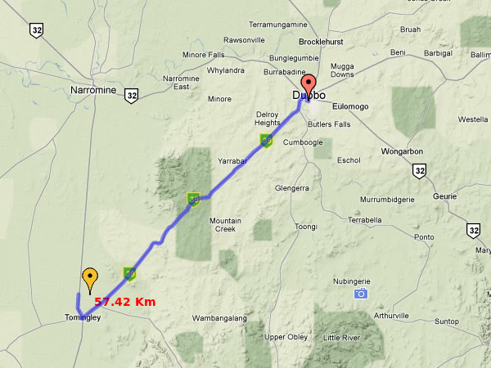
Transportation&Logistics_VTS/GeoILS_Scenarios

Slide 20

Transportation&Logistics_VTS/GeoILS_Scenarios
If you are interested to purchase our VTS/GeoILS/GeoMAP and need more info or for Free Demo feel free to contact us thru geospatialconsultant1@gmail.com

